Slide 1
Predicting Continued Popularity of Games on Twitch
Daniel Ansted

Slide 2
Executive Summary
Our machine learning model could allow us to target an estimated 5.37% more viewers compared with baseline predictions

Slide 3
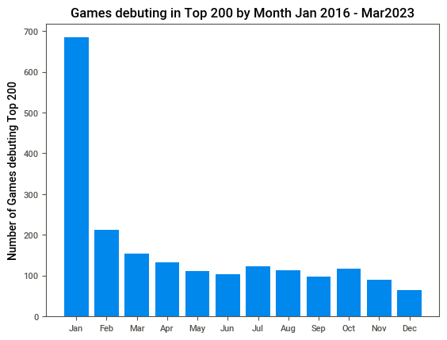
Notes:
Approximately a third of the games in the dataset first appeared in the top 200 in January. Granted the dataset starts in January of 2016; however, even subtracting the 200 from the January total it would still be more than double February, it’s nearest competitor. And games debuting in the top 200 in January make up approximately 1/3 of the games in the top 200 from Jan 2016 - Mar 2023

Slide 4
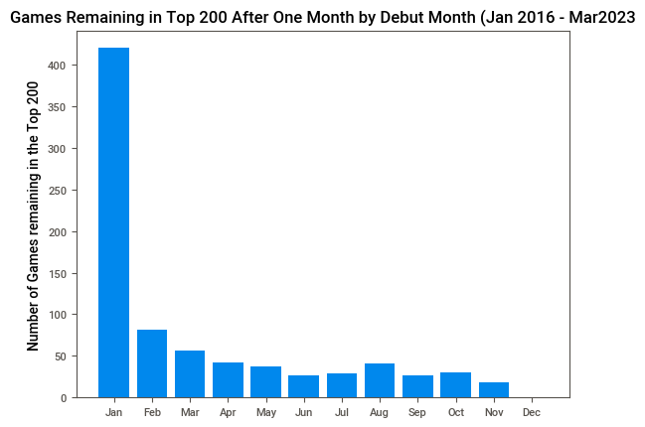
Notes:
Games debuting in January out performed games debuting in all other months. They account for ~52% of the games that remained in the top 200 in the next month. Another surprise is not not a single game that debuted in the top 200 in December remained in the top 200 next month. January debut month was added as a feature to the machine learning model.

Slide 5
Baseline Prediction for Top 200 Prediction
809 games continued to be in the top 200 1 month after their debut
The top 809 games ranked by hours watched were predicted to remain in the top 200, and the rest were predicted to drop from the top 200
A similar analysis was performed for 3 and 6 months after debut

Slide 6
Machine Learning Model for Top 200 Prediction
Logistic Regression and Random Forest Classifier were both assessed for 1 month after debut
Random Forest was slightly better, but not significantly. It was used for the remaining analyses
Notes:
'max_depth': 7, 'min_samples_leaf': 5,

Slide 7
Accuracy of Baseline and Model 1, 3, and 6 Month After Debut in the Top 200
 | 1 Month Accuracy | 3 Month Accuracy | 6 Month Accuracy
Baseline Prediction | 68% | 83% | 100%
Random Forest | 80% | 90% | 100%
Notes:
Data from 1 month after debut was used to predict whether a game would be in the top 200 3 months after debut and likewise the 3 month data was used for 6 months after debut. Hence the increase of accuracy all the way up to 100% at 6 months after debut.

Slide 8
Baseline and Random Forest Regression
A regression analysis was performed to attempt to predict hours watched one month after debut for games that remained in the top 200 after one month
A Random Forest Regression was compared to linear regression for the 1 month data
The Random Forest Regressor greatly out performed the linear regression

Slide 9
Baseline And Random Forest Regression
Random Forest Regressor was used for the remaining analyses
Two baseline predictions were used to compare the model
Hours watched during the debut month adjusted by the median difference of hours watched between the time points
Hours watched during debut month

Slide 10
1 Month After Debut Regression Results
 | Median Based Prediction | Hours Watched Prediction | Random Forest Regressor
r² | .37 | .37 | .57
MAPE | 115% | 121% | 105%
3 Month After Debut Regression Results
 | Median Based Prediction | Hours Watched Prediction | Random Forest Regressor
r² | .56 | .50 | .71
MAPE | 149% | 122% | 106%

Slide 11
6 Month After Debut Regression Results
 | Median Based Prediction | Hours Watched Prediction | Random Forest Regressor
r² | .48 | .90 | .58
MAPE | 122% | 55% | 65%
Notes:
As you can see the Random Forest Regressor performs modestly better than the baseline prediction up until the 6 month point, where a game that has been popular for 3 months is virtually guaranteed to be popular for another 3 months. Only data from 1 month and 3 month was used for the 6 month predictions

Slide 12
Conclusion
The top 200 games from Jan 2016 - Mar 2023 have accounted for approximately 91% of Twitch viewership
Our Classification Model was 12 percent more accurate than the baseline prediction and
The increase in accuracy likely comes from the games ranked between 136-160 each month
Notes:
In 2022, the last calendar year 25% of the games that broke into the top 200 did so in January, 75% remained popular in Feb.

Slide 13
Conclusion
These games account for approximately 5.37% of Twitch viewership, increasing our ad exposure accordingly
Finally each year in January, we should assess popular games in near real time to get an early lead on the popular games for the next several months
Notes:
In 2022, the last calendar year 25% of the games that broke into the top 200 did so in January, 75% remained popular in Feb. For 2023 until March, half the games that broke into the top 200 did so in March and 59% remained in the top 200.

